Slide 1
RECLAIMED IDENTITIES:
Contemporary Practice in
Personal Injury &
Medical Negligence
Thursday 19 September
2019
Burnley Football Club

Slide 2

JAMES GRATTON
SOLICITOR & HEAD OF PERSONAL INJURY DEPARTMENT

Slide 3
ELECTIVE AMPUTATION
&
OSSEOINTEGRATION
A case study
Jonathan Greenall

Slide 4
Jonathan Greenall
Accident: 26 December 2014
Settlement: 12 April 2019
Injury: De-gloving injury to right foot following running down and over by a reversing fork lift truck

Slide 5
Jonathan was an HGV driver delivering goods for a major supermarket group to a distribution warehouse on the Wirral at time of accident.

Slide 6
He had previously been a combat medic in the Army having served in Iraq and Afghanistan.
JG was run over by a FLT when exiting the toilets in the Distribution Centre.

Slide 7
There was a distance of about 2 paces from the toilet door to where FLTs were moving about with no separation of pedestrians from vehicles. FLTs had no horns or lights.

Slide 8
Following
the accident a barrier
was added to keep pedestrians and vehicles apart at a cost of £2K.
Requirement Regulations
of the Workplace 1992 to separate
pedestrians from moving vehicles.

Slide 9
Premises opened in 1998 and D in breach since that date.
Driver had not appreciated that he had knocked Jonathan down.

Slide 10
Thus driver reversed over Jonathan initially and then drove forward, back over his right foot.
Primary liability was readily conceded.

Slide 11
Contributory negligence at 20% was alleged, but without real conviction or indeed likelihood of success.
Proceedings issued 12 May 2017.

Slide 12
Consultation in the UK with A/Professor Munjed Al Muderis of the Macquarie Hospital in Sydney, Australia and Mr Norbert Kang of the Royal Free Hospital on 15 May 2017.

Slide 13
A/Professor Al Muderis along with Mr Kang advised Jonathan that the foot was not viable in the long term.

Slide 14
A/Professor Al Muderis advised that unusually (it had never been done before) he would agree to perform an elective amputation and osseointegration in Sydney as soon as it could be arranged.

Slide 15
Interim payments of £95K as at date of issue.
Judgment in acknowledgement
default of
of service
ordered on 5 June 2017.

Slide 16
Application for interim payment of
£905K made on 31 May 2017 with a return date of 6 July 2017.
£700K agreed at hearing as against no offer until 2 days before IPA when £350K was offered and rejected.

Slide 17
Moved to rented bungalow wet room 1 August 2017.
with
Jonathan flew
5 August 2017.
to Australia on

Slide 18
Elective amputation
and
osseointegration undertaken in Australia on 9 August 2017.

Slide 19
Adapted vehicle – VW Caravelle – supplied September 2017.
CCMC - 12 September 2017 – Claimant’s costs budget approved
£1.1M+.

Slide 20
Why elective surgery with osseointegration and why not a socket?

Slide 21
JG suffered a degloving injury to right foot as can be seen in the
following taken in
medical photographs surgery and shortly
afterwards in December 2014.

Slide 22
Warning!
Some of the following images are
GRUESOME!

Slide 23
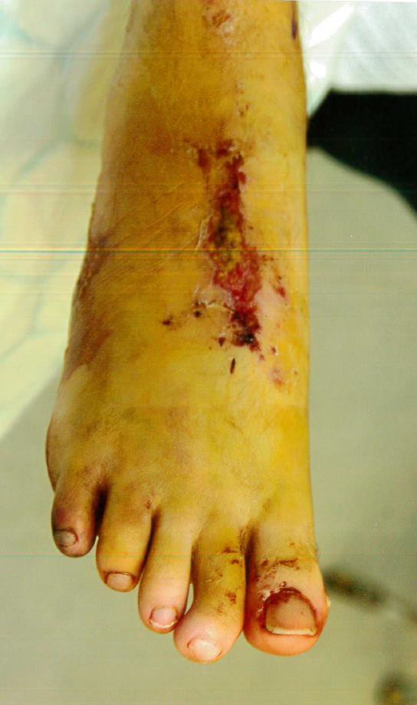

Slide 24
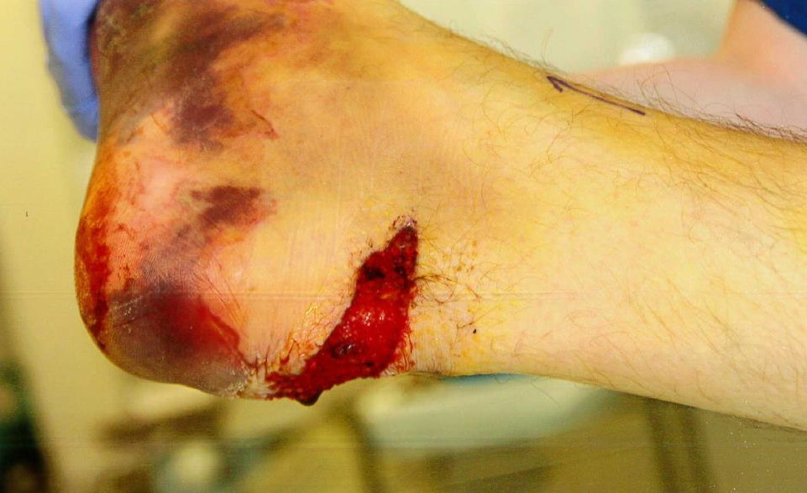

Slide 25
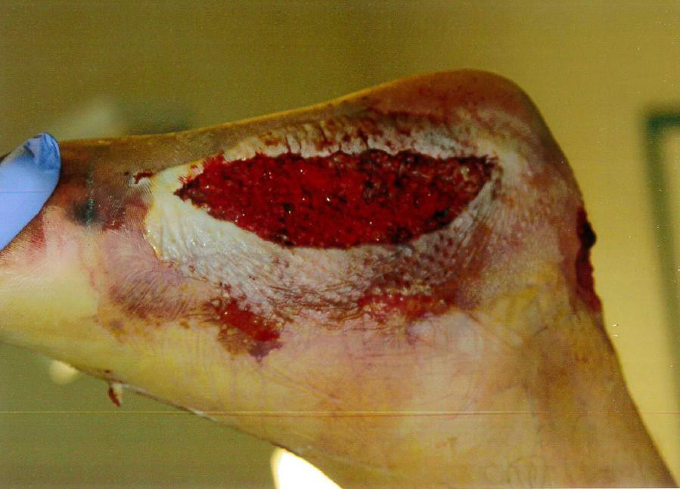

Slide 26
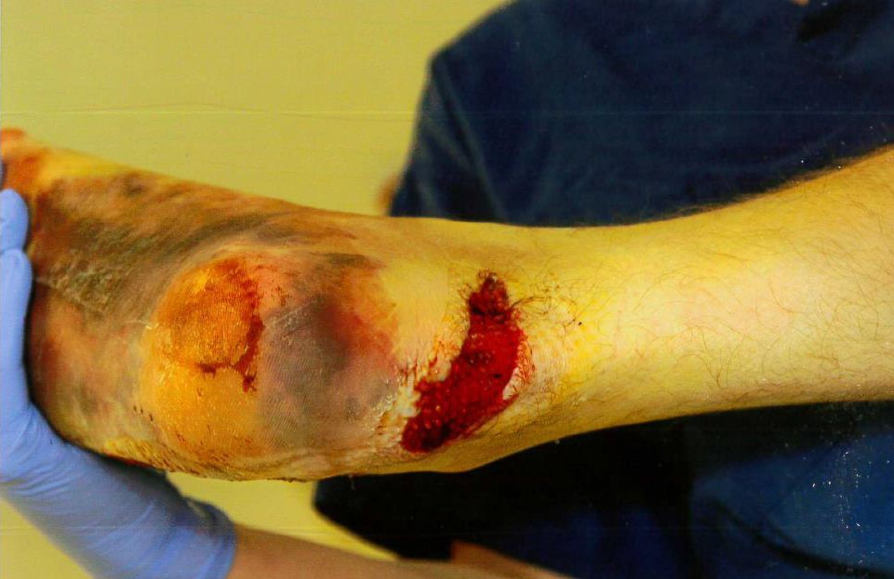

Slide 27
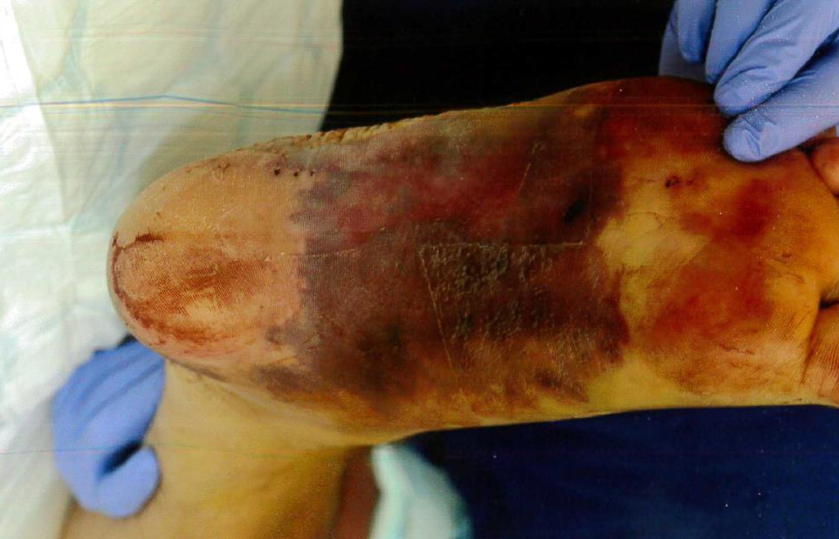

Slide 28
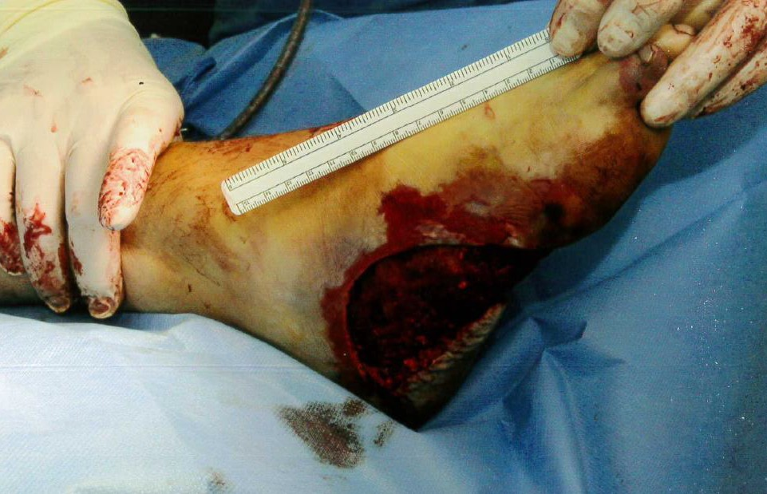

Slide 29
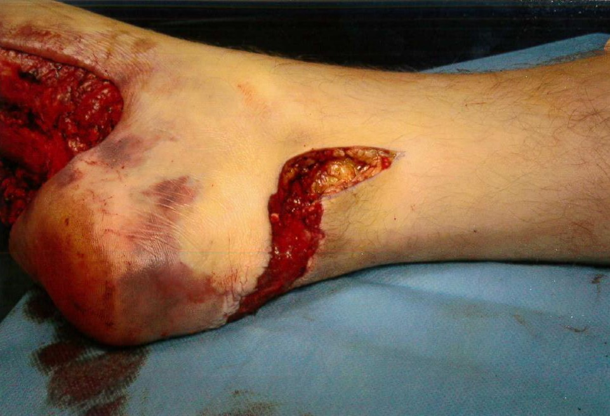

Slide 30
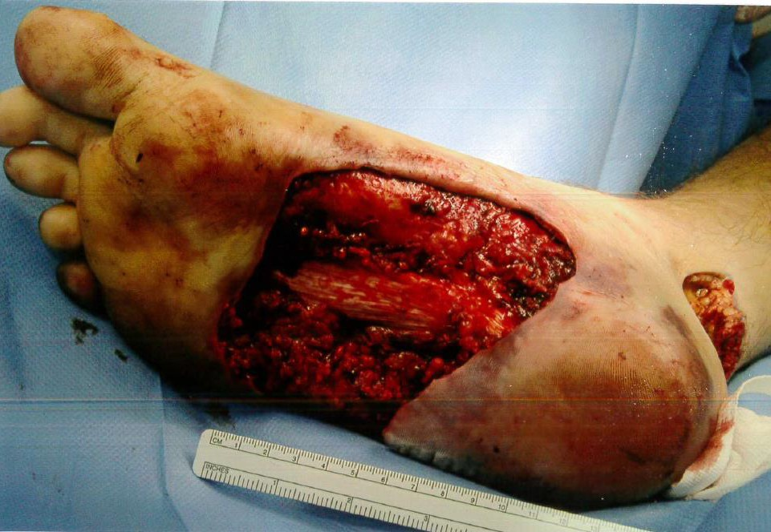

Slide 31
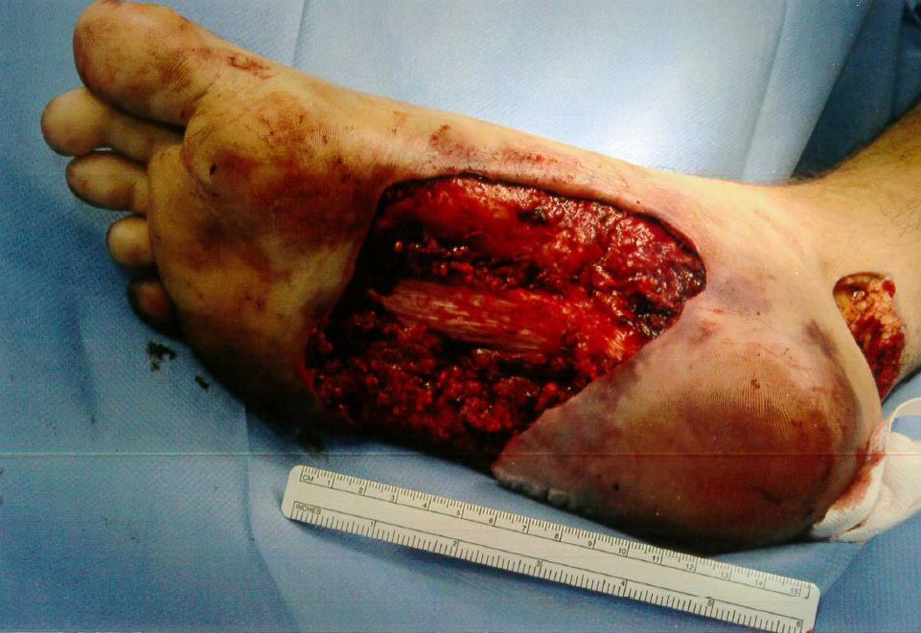

Slide 32
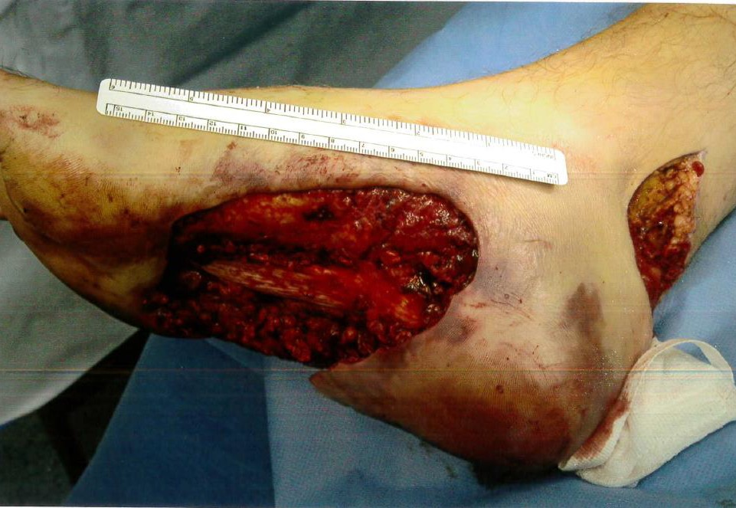

Slide 33
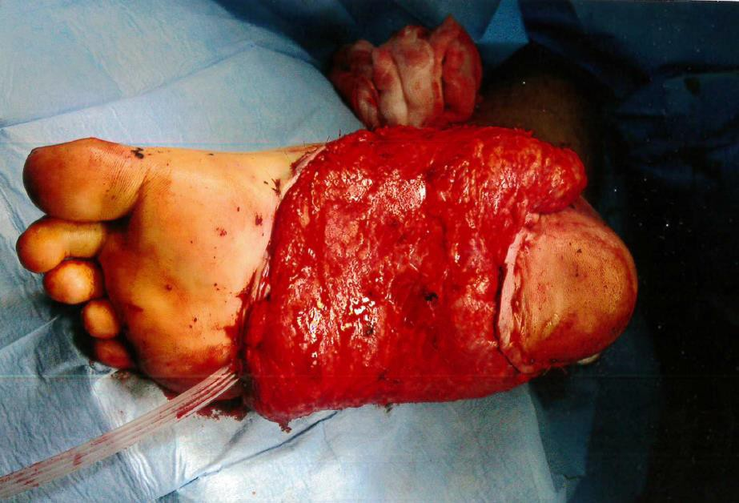

Slide 34
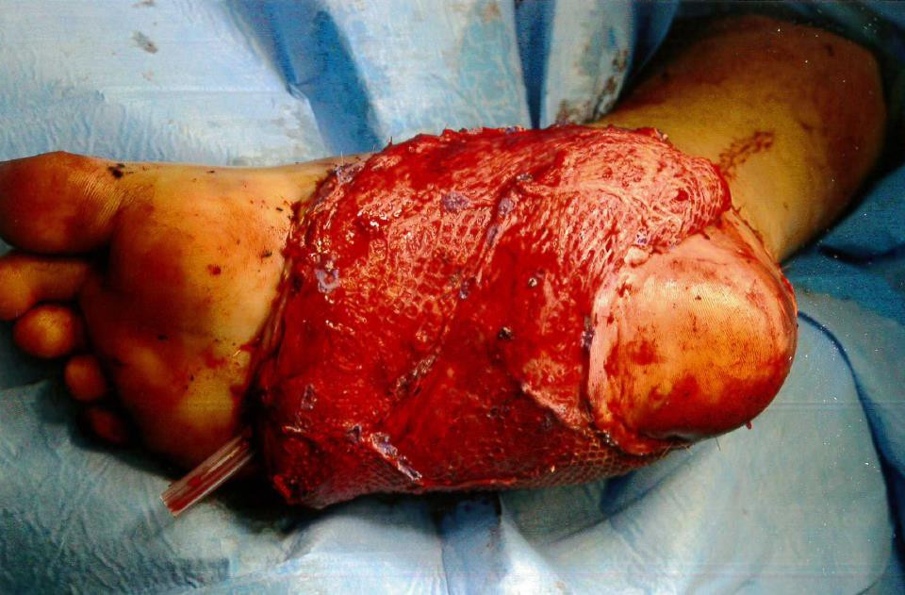

Slide 35
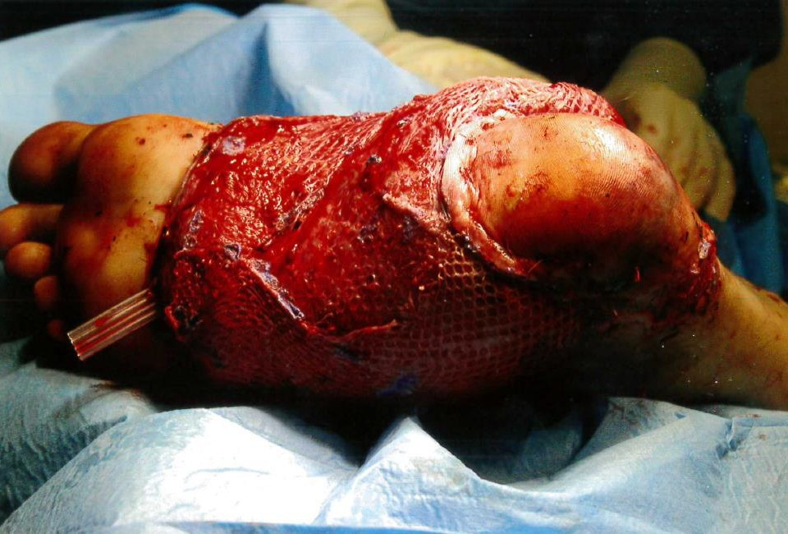

Slide 36
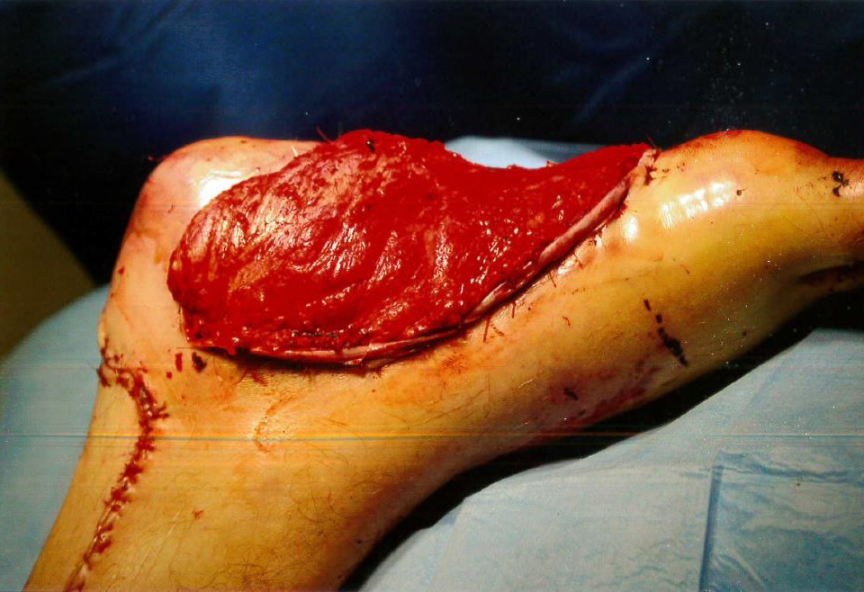

Slide 37
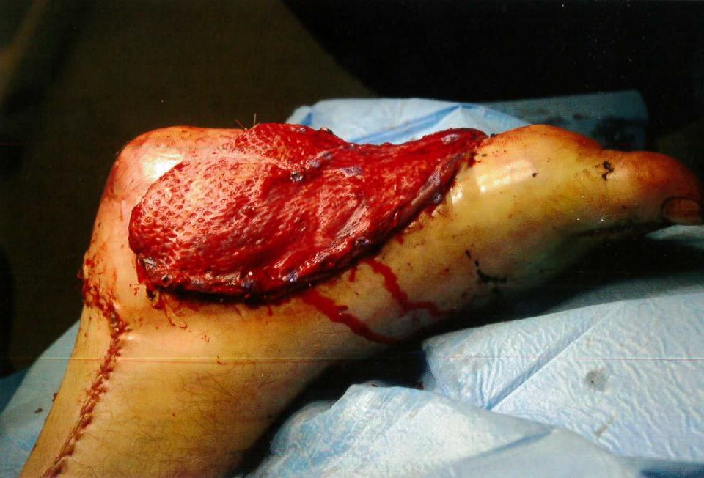

Slide 38
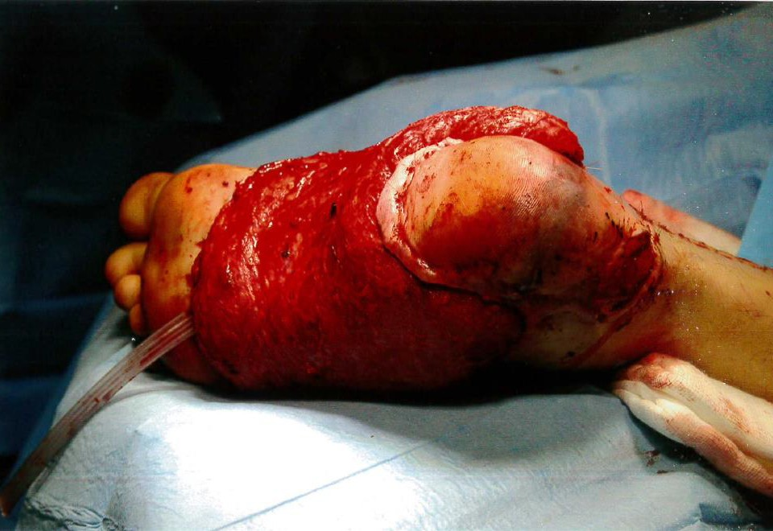

Slide 39
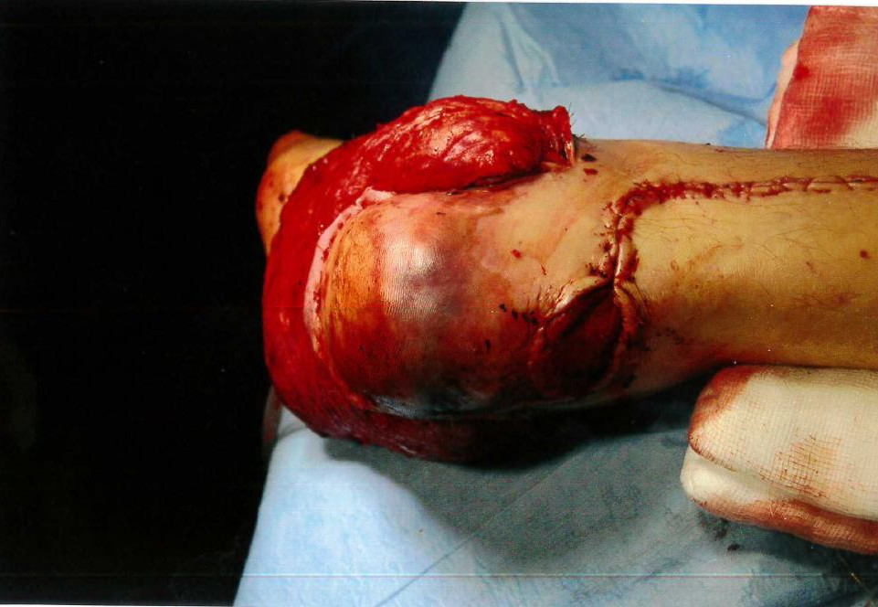

Slide 40
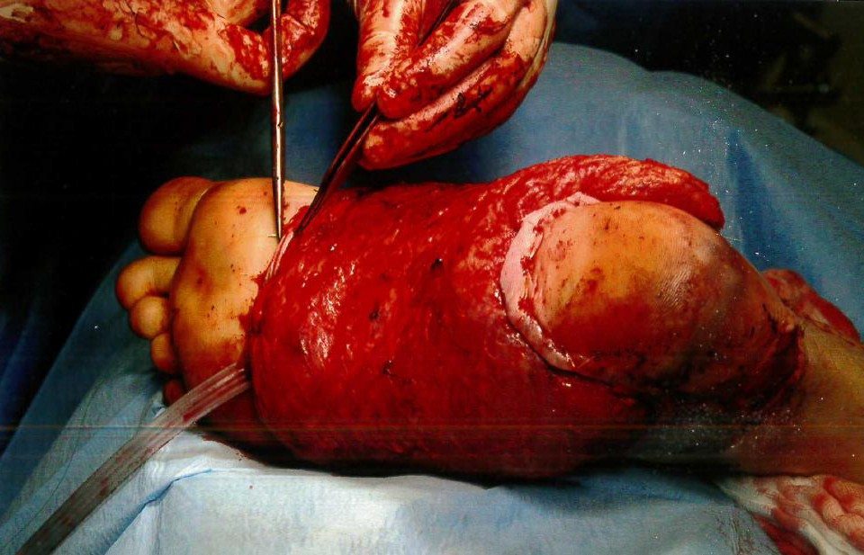

Slide 41
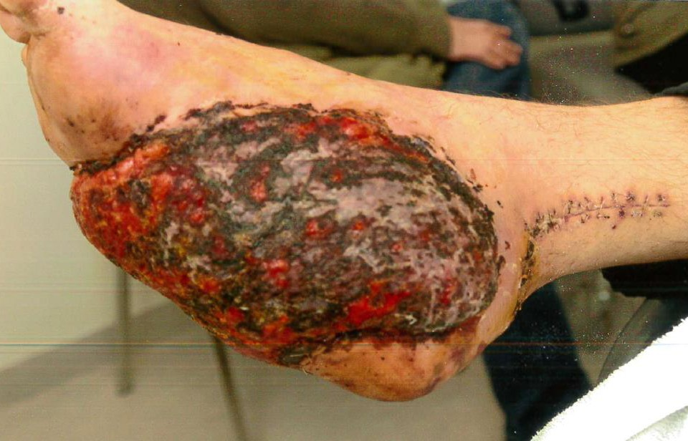

Slide 42
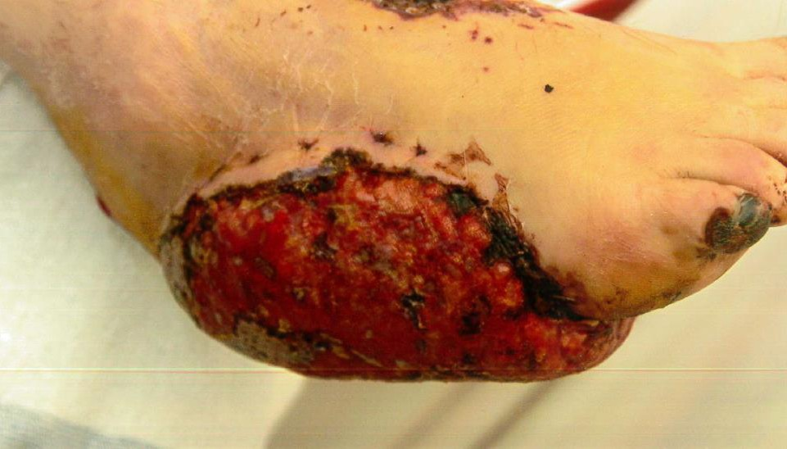

Slide 43
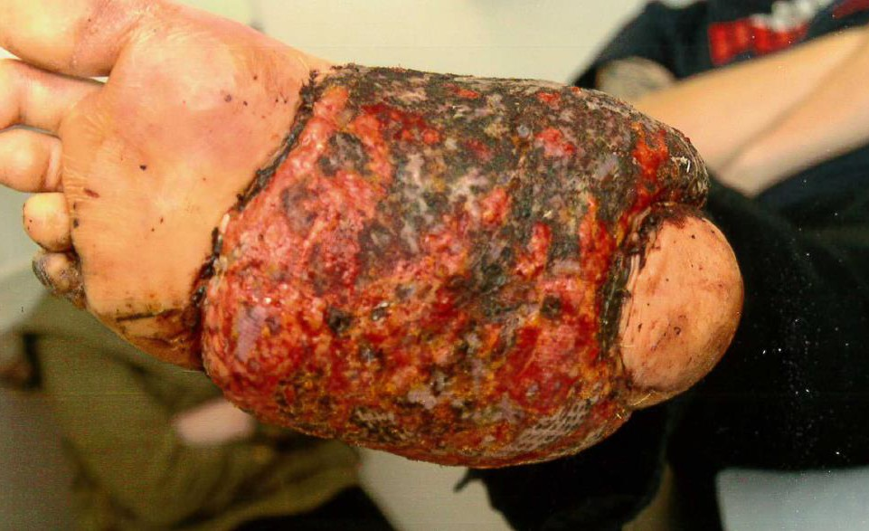

Slide 44
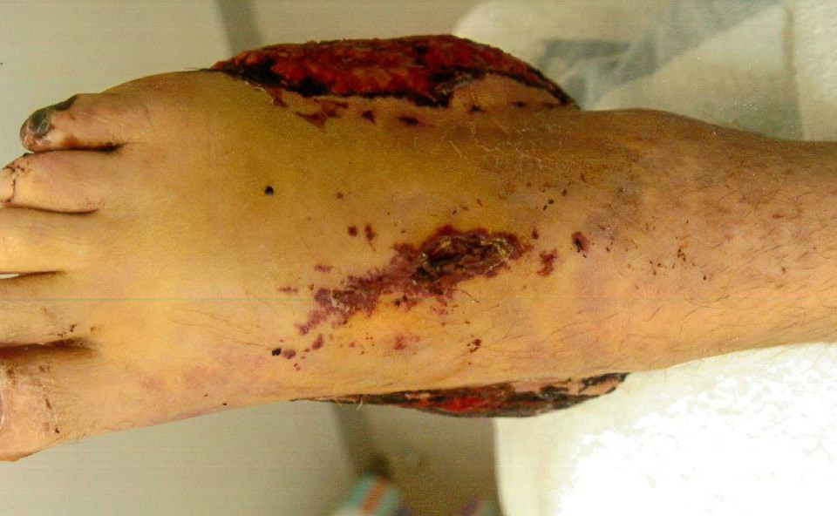

Slide 45
JG had a free flap transfer whereby skin and muscle tissue was taken from his back with further skin grafts from the thighs.
Resulting in hypertrophic scarring to the back – likely to require laser revision in due course.

Slide 46
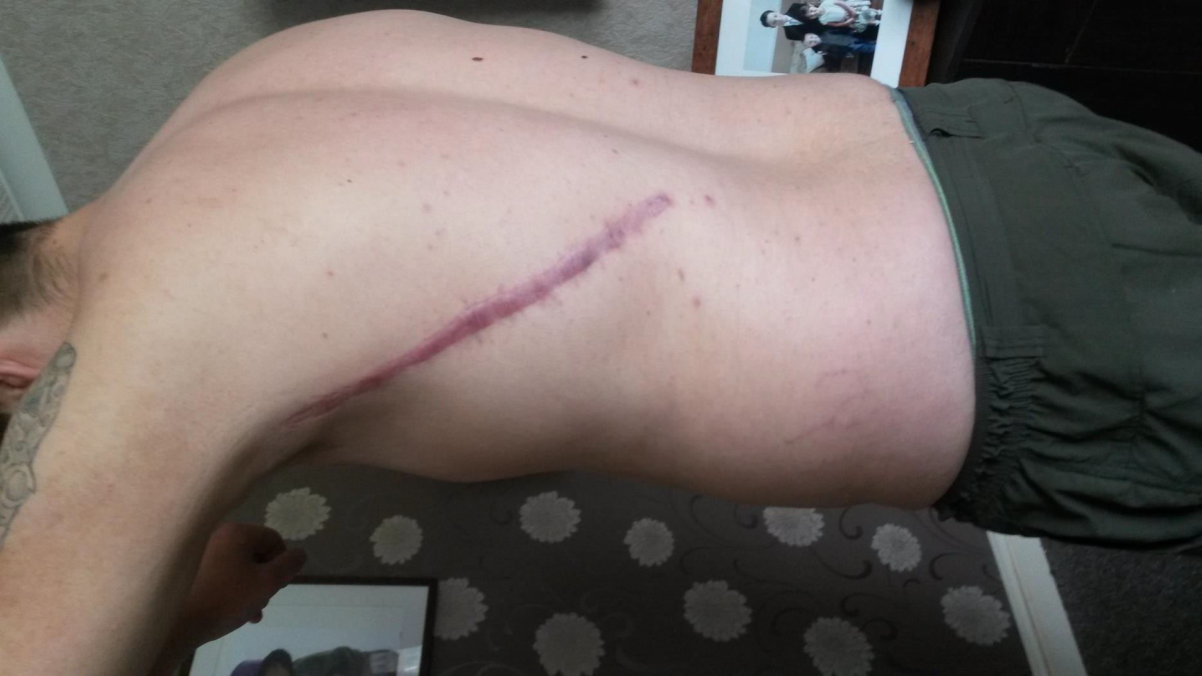

Slide 47
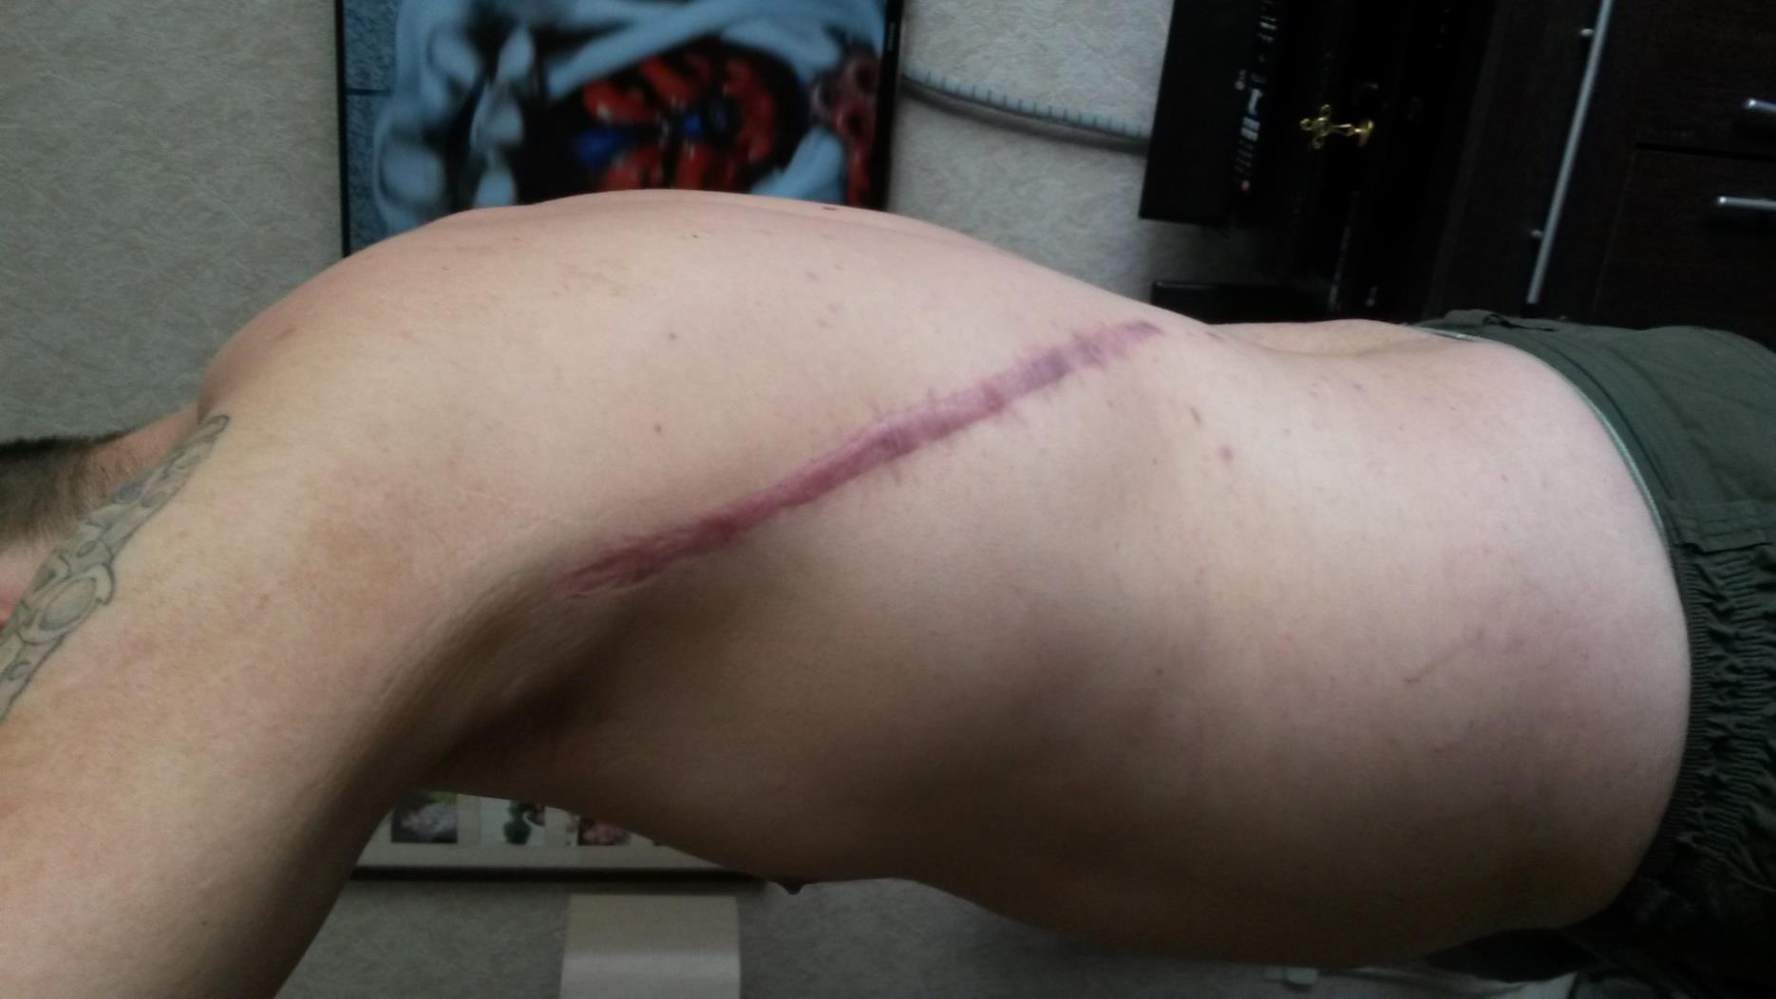

Slide 48
A number of surgical procedures designed to save and restore function to the foot over the course of the following 2 years – about a dozen all told.

Slide 49
A second series of revision surgeries in late 2016 required emergency further surgery following the development of a clot.

Slide 50
Jonathan was for about half of that period of 2 years or so following the accident and surgeries mobilising in a wheelchair and on crutches.

Slide 51
When walking he had an antalgic gait, walking on the toes and needed a stick and sometimes a wheelchair to mobilise out of doors.

Slide 52
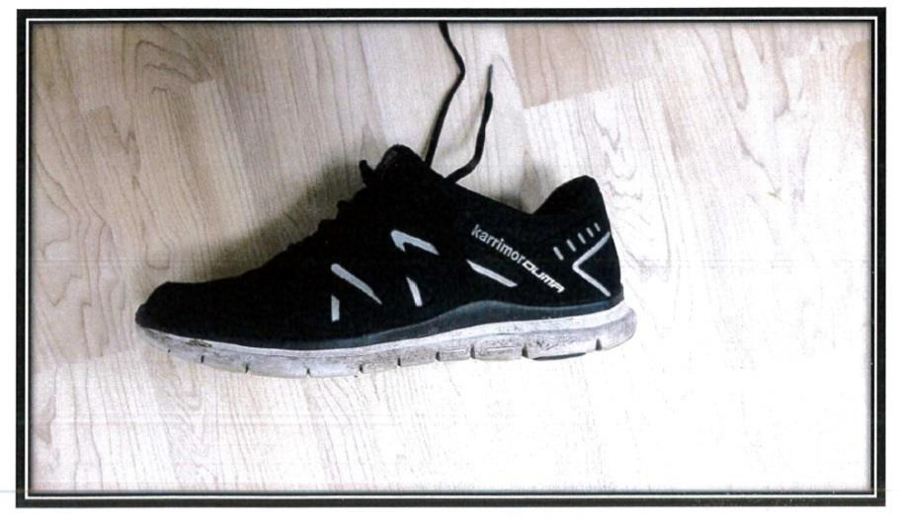
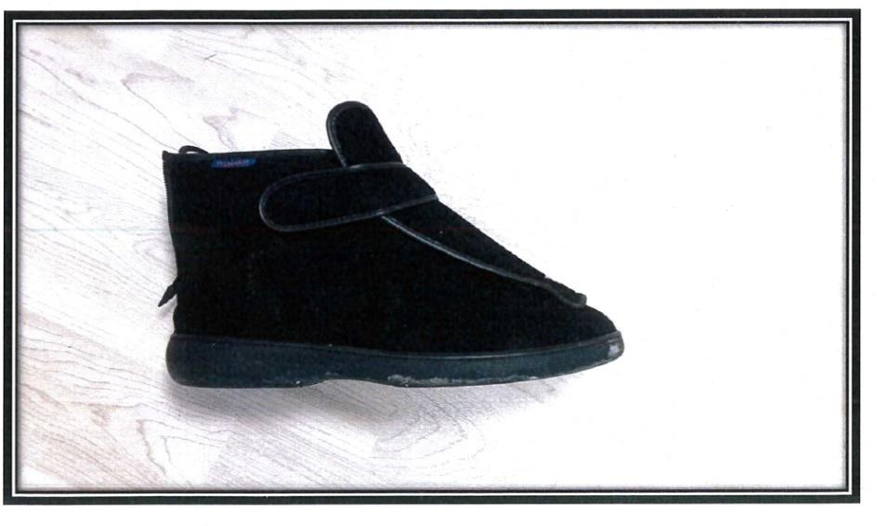
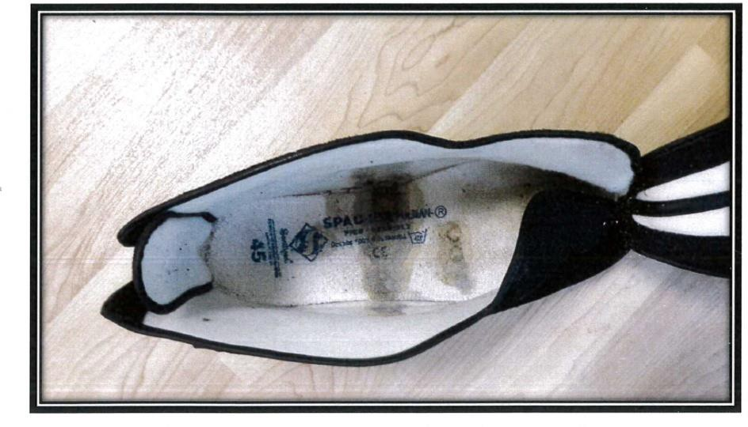
JG’S LEFT TRAINING SHOE
JG’S RIGHT PULMAN BOOT
VIEW INSIDE JG’S PULMAN BOOT
SHOWING WOUND LEAKAGE

Slide 53
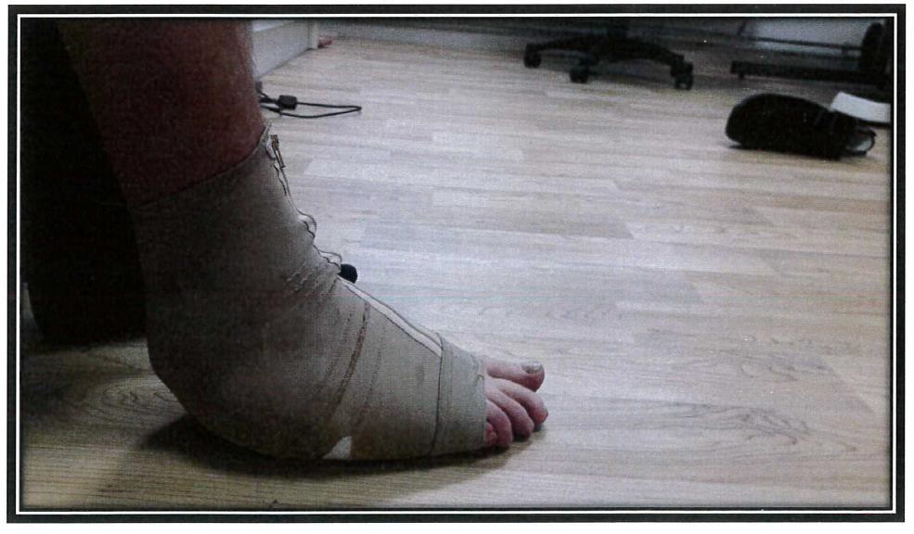
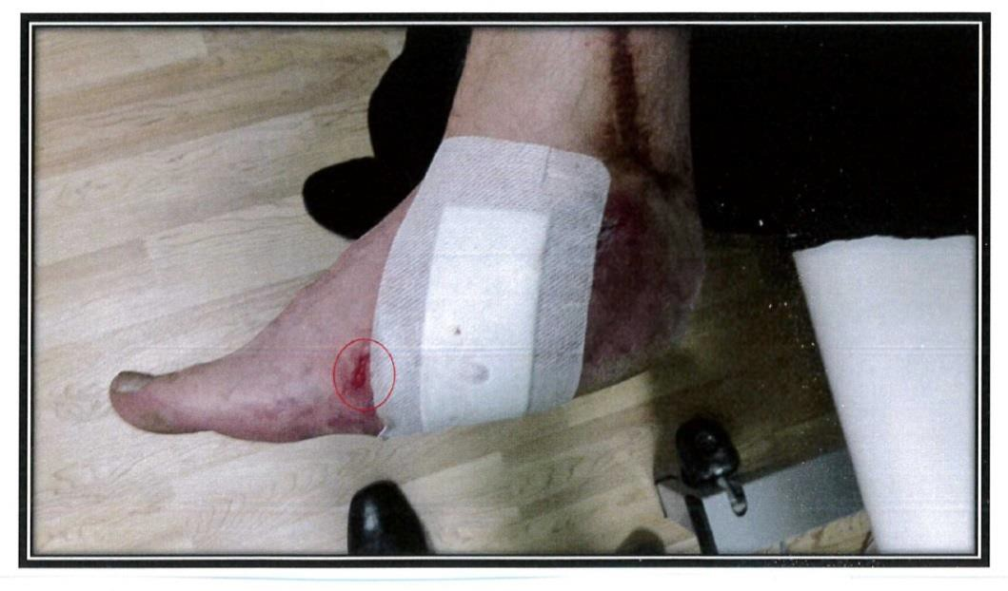
JG WEARING PRESSURE GARMENT TO HIS RIGHT FOOT
CUT TO JG’S FOOT FOUND UNDER COMPRESSION GARMENT

Slide 54
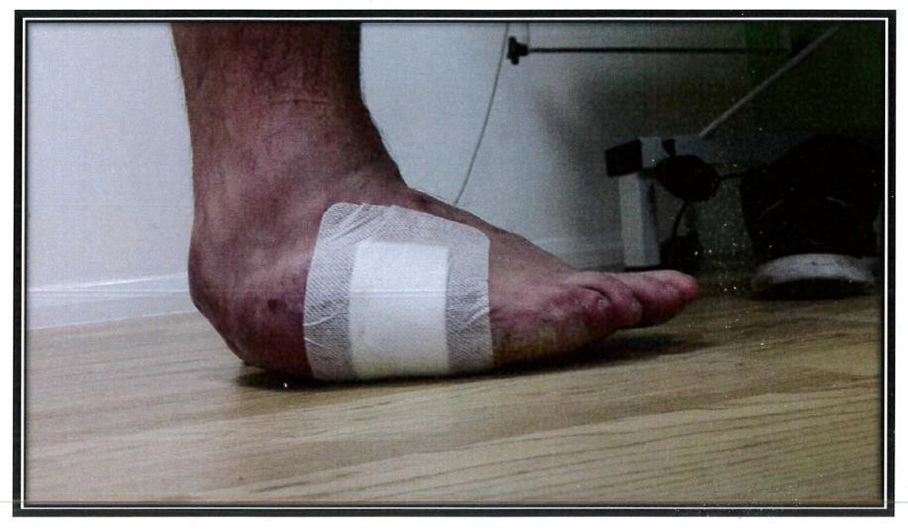
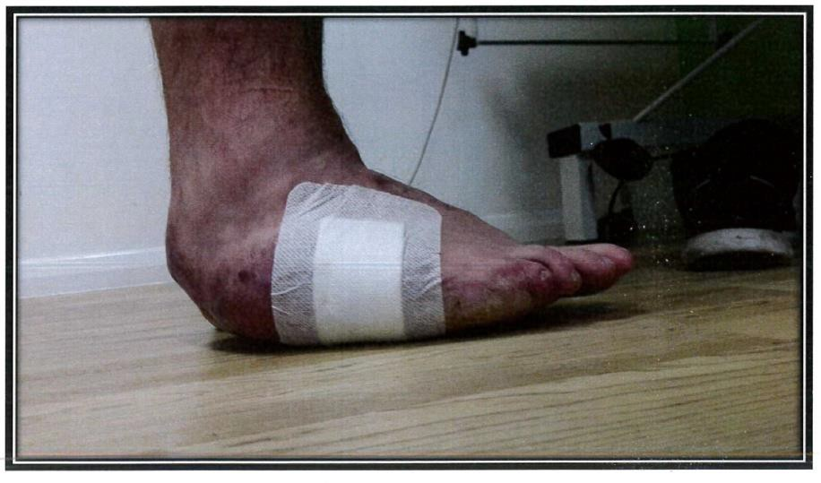
JG’S RIGHT FOOT – HEEL DOWN
JG STANDING WITH HIS HEEL DOWN SHOWING THICKNESS OF SKIN GRAFT

Slide 55
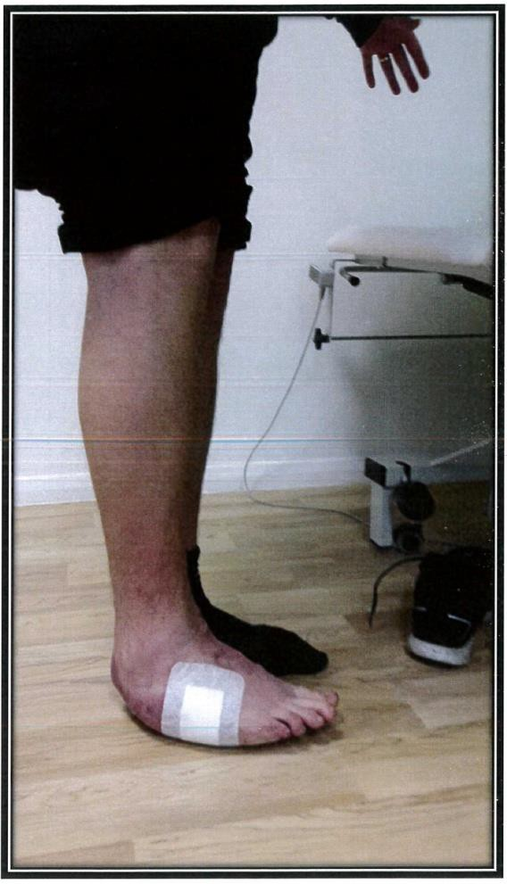
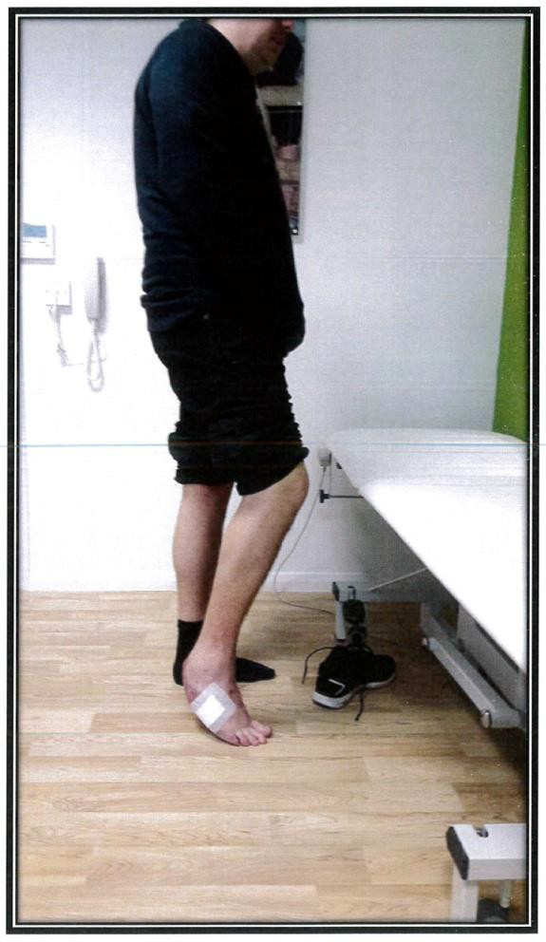
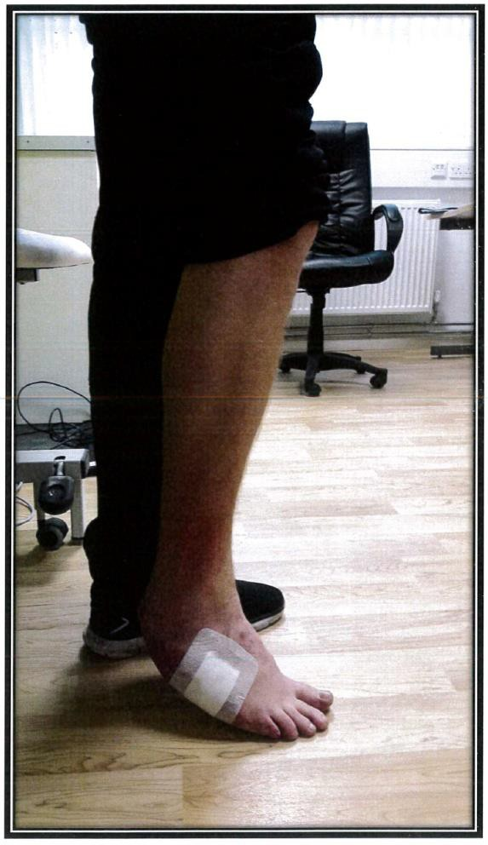
JG STANDING WITH HIS HEEL DOWN SHOWING RAISED FOREFOOT
JG STANDING ON HIS TOES
JG STANDING ON HIS TOES

Slide 56
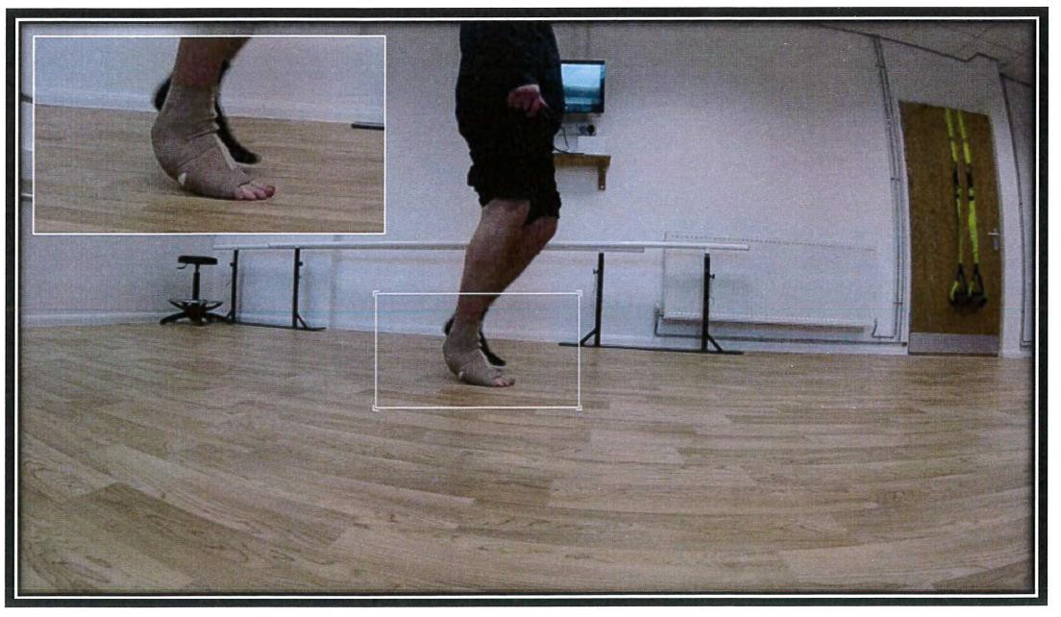
JG WALKING
SHOWING INITIAL CONTACT ON THE RIGHT SIDE IS ON THE TOES

Slide 57
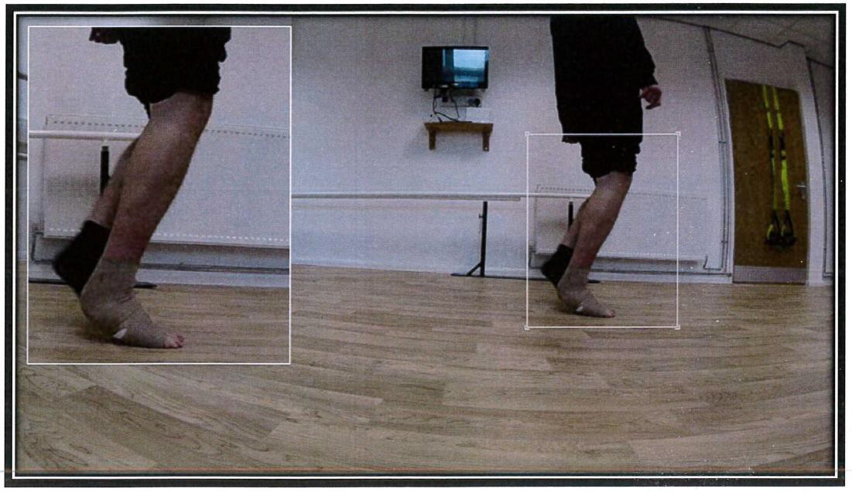
JG IN MIDSTANCE
SHOWING RIGHT FOOT IS IN PLANTARFLEXION

Slide 58
pain and dose of
in constant maximum
JG was
taking the Tramadol.

Slide 59
Required extensive care and assistance.
Suffered a reactive depression.
Suffered a loss of employment.
Unable to drive.

Slide 60
Foot very swollen and unable to wear anything other than a Pullman boot.
Always in compression bandage.
Exudate and foul odour.

Slide 61
He required a stair lift and assistance to bathe.
A Momentum off-loading brace was tried and found wanting.

Slide 62
As former combat medic had some
experience of amputations and prosthetics with colleagues
traumatic
socket based
injuries to of
and was
aware
potential socket issues.

Slide 63
Osseointegrated prosthetics are worn over 100 hours per week by users.

Slide 64
As against about 50 hours per week by socket users, according to a
the team,
German whose
survey by
osseointegration
patients of course all came to them with sockets.

Slide 65
Osseointegration
Comes from work by Brånemark in Sweden.
Common now in terms of dental implants.

Slide 66
Same scale.
principle
but on a larger
Offered in Sweden, Holland, Germany and Australia.

Slide 67
Australian team use the most up to date surgical technique and implant device and surgery involves one operation where the stump is refashioned – generally straight across in non-elective cases – and the implant is inserted.

Slide 68
Weight bearing is following day after
started the surgery and
mobility is achieved within a couple of weeks or so.

Slide 69
1 week as an in-patient and then 2 weeks of out-patient care.
No high impact activities for at least 12 months post-implantation.

Slide 70
No smoking for at least 6 weeks prior to surgery and preferably not again post-surgery. Nicotine affects knitting together process so vaping and nicotine replacement not indicated.

Slide 71
Running and swimming are not advised but patients do and none have come to grief to date.
Less than 1,000 people worldwide have osseointegration.

Slide 72
European teams use a 2 stage procedure – refashion stump and insert implant with abutment placed 6 – 8 weeks later in further surgery.

Slide 73
Mr Norbert Kang at the Royal Free is now doing the Australian method in the UK as from 2018, having trained with A/Professor Al Muderis.
Also offered in the UK at the London International Patient Services – using the Swedish method?
Not available at either facility on the NHS.

Slide 74
MoD has sent soldiers to Australia for osseointegration.
Can be for above or below knee patients, even with very short femoral residuum.

Slide 75
Can also be used for upper limb patients - useful in cases where
there is a amputation insufficient
high trans-humeral where there is remaining residuum
length to support a socket.

Slide 76
Australian team have done same for at least 2 high upper limb patients that I know of, including one UK patient aged 59 with amputation at 18, with TMR and myoelectric prosthesis.

Slide 77
Cost of osseointegration in Australia:
Surgery: £70K*
* Includes hospital fees, transfers and studio flat accommodation for patient, but not flights or subsistence once discharged from hospital.
Rehabilitation: £20K

Slide 78
Proflex foot:
£ 6K
Aquatic foot:
£10K
EmPOWER:
£57K
Running blade:
£ 6K

Slide 79
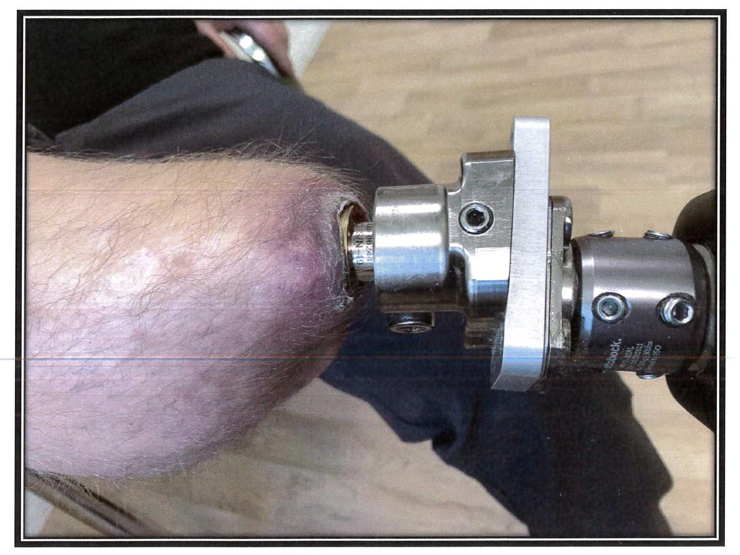
Jonathan has had successful surgery.
JG’S OSSEOINTEGRATION SITE ANTERIOR VIEW

Slide 80
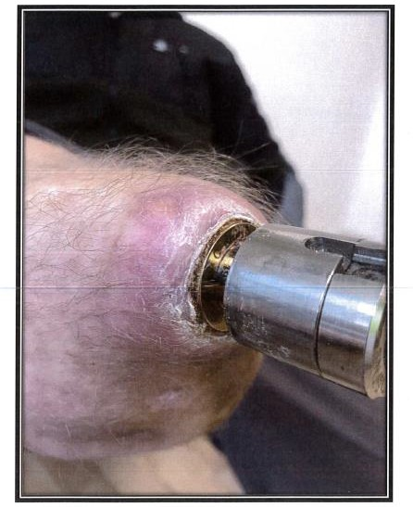
JG’S OSSEOINTEGRATION SITE
CLOSE VIEW

Slide 81
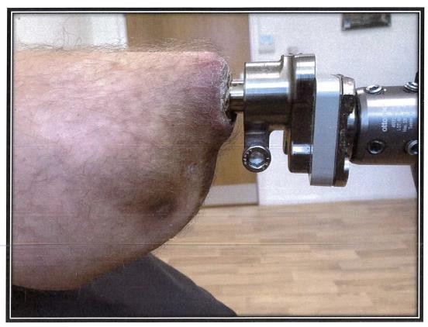
JG’S OSSEOINTEGRATION SITE
LATERAL VIEW

Slide 82
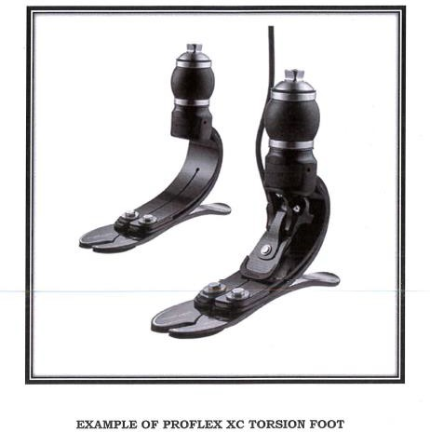

Slide 83
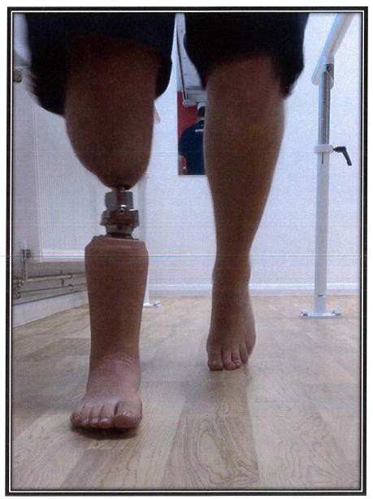
JG’S SILICONE WATER ACTIVITY PROSTHESIS

Slide 84
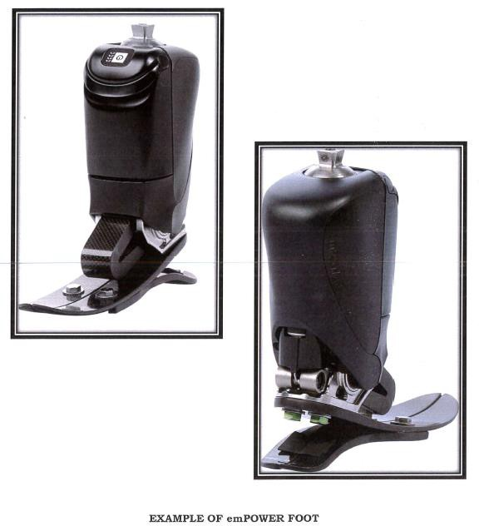

Slide 85
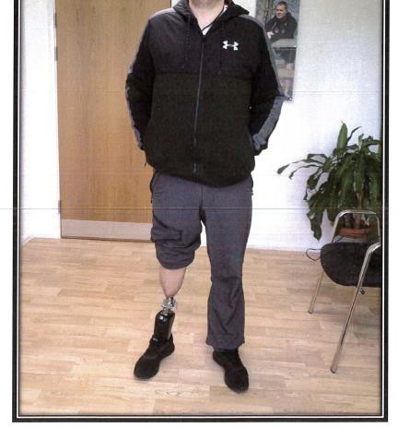
JG WEARING HIS emPOWER PROSTHESIS

Slide 86
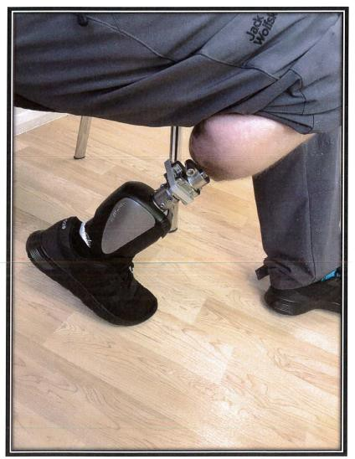
JG DEMONSTRATING HIS UNRESTRICTED
KNEE FLEXION POSITION

Slide 87
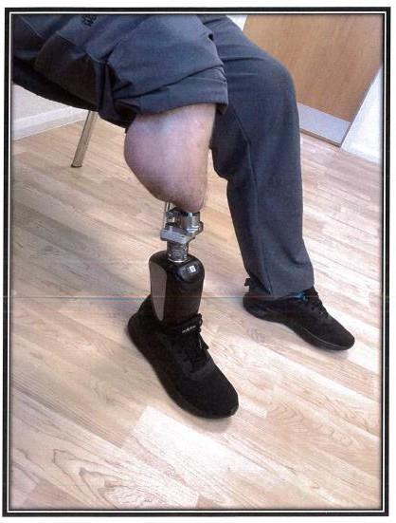
JG RELAXED SITTING POSITION WITH THE emPOWER PROSTHESIS

Slide 88
6 weeks’ managed
Minor infection post-surgery with antibiotics.
3 further minor infections but no further problems.

Slide 89
Has been snowboarding on a dry slope earlier this year with no after effects – at least not on the injured leg.

Slide 90
Serious Injury affects the whole family and no doubt there are difficult conversations to be had …

Slide 91
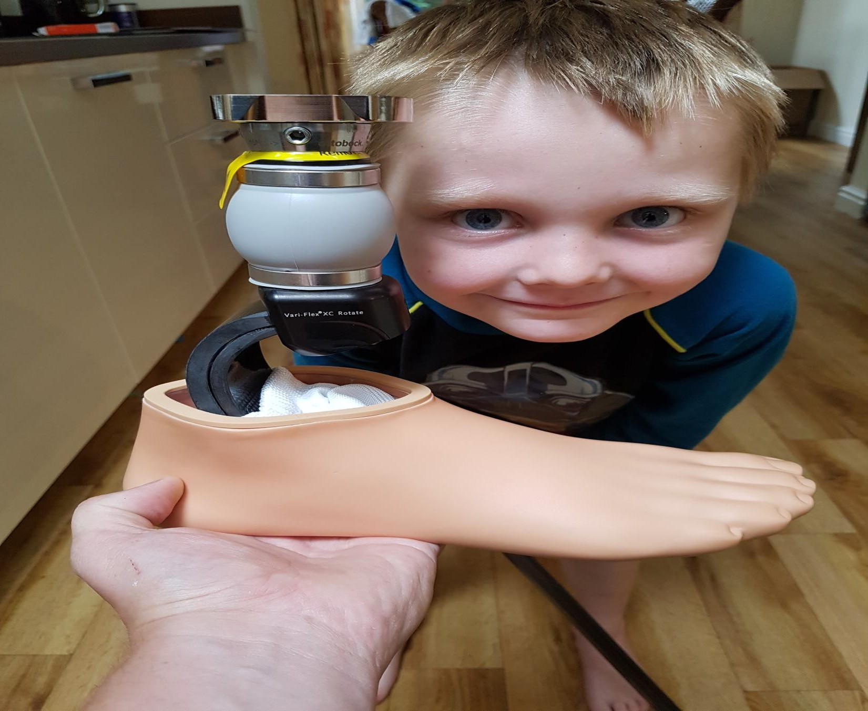

Slide 92
Prior to the accident, Jonathan was an HGV driver and married with two small children.
Following the accident, he was in and out of surgery for two years and suffered constant pain, taking the maximum dose of Tramadol and he was markedly depressed.

Slide 93
Jonathan was unable to see that even if he were to be awarded compensation, very much would change. He would still be in pain, unable to socialise, engage in sporting activity or be active with his children. His identity as the family breadwinner was lost forever.

Slide 94
Following amputation and osseointegration, Jonathan’s pain ended immediately. There were some phantom sensations for a short while afterwards and a few minor infections requiring antibiotics.

Slide 95
But he was pain free and within 2 weeks mobilising on crutches.
By week 12 post-surgery, Jonathan was able to walk without crutches or a stick.
His gait is now normal.

Slide 96
Jonathan is now able to engage in his pre-accident activities of snowboarding and fishing, walking and cycling.

Slide 97
Since settlement Jonathan has purchased a wholesale fishing tackle business which is doing very well and already providing him with a very healthy income and he has reclaimed his role as family breadwinner.

Slide 98
Whilst of course he would not have wanted to have suffered the accident and the nightmare 2.5 years which followed it, Jonathan feels that his life is now better than it was prior to the accident.
E N D

