Slide 1
RECLAIMED IDENTITIES
Litigation, rehabilitation and the road to recovery
Chris Smith and Steve Cook
Notes:
Intro – Title

Slide 2
Where to begin?
Period immediately following accident is a bewildering time
Establish priorities Rehabilitation
Care
Funding
Housing
Adaptations and equipment
Do I have a claim?
Notes:
Do I have a claim, what makes up a claim?
Initial meeting at Pinderfields
Steve, Louise & mother-in-law
Steve – what were your initial thoughts?

Slide 3
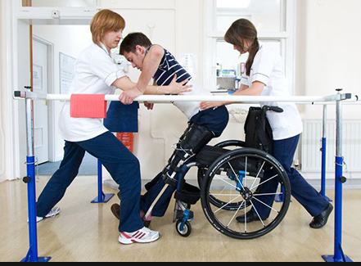
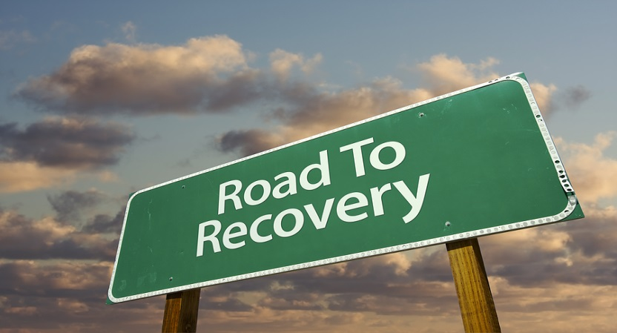
Rehabilitation
Role of solicitor – put the Claimant at the centre of the process
Maximising Recovery
Case Managers and the Immediate Needs Assessment
Establishing a multi-disciplinary team
Holistic approach
Rehabilitation Code of Practice 2015
Notes:
The initial assessment
Funding
Private Funding
Rehab Code
Hybrid
SC – Rehab Code initially INA – then IP’s
Collaborative approach – way forward

Slide 4
Contact and Collaboration
The Defendant – preserving evidence and
maximising early opportunities
Liability and Quantum
Transition from hospital to home
Notes:
Opportunities in rehab and in the case
What insurers / solicitors want from rehab
What are the client’s priorities

Slide 5
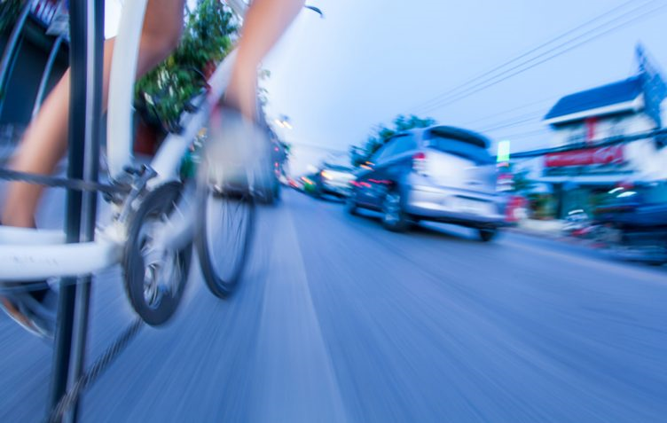
Steve’s Case
Accident and Rehabilitation
Discharge
Priorities
Notes:
Brief background of the accident and injuries
Hospital and further rehab at Pinderfields.
Moving home – stair lift – bike in conservatory
Your priorities immediately after the accident

Slide 6
Interim Payments
Can be crucial for a Claimant
Early and realistic requests
Rehabilitation
Accommodation
Notes:
Moving home – incredibly big decision for the entire family
S&L found a bungalow
Collaboration with D. Accommodation experts assessed property
Released interim payment – purchase property
Joint site visit with D sols and insurers – interim payment to adapt property

Slide 7
NeuroPhysics Therapy
Exercise-based treatment
Engages and triggers the body’s natural healing processes
Light and controlled resistance training
Notes:
Paralympian John Maclean
August 2016 six-week rehabilitation programme with Ken Ware
NeuroPhysics Therapy is an exercise-based treatment that engages and triggers the body’s natural healing processes through very light and controlled resistance training.
Having been told that he would probably never walk again, Steve took his first unaided steps during that trip to Australia.

Slide 8
NeuroPhysics – August 2016

Slide 9
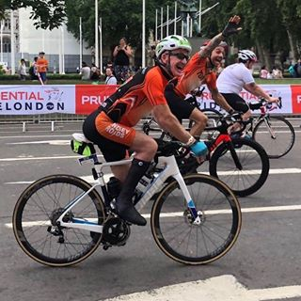
Road to recovery
Further rehab in the UK
Settlement of the case
Second trip to Australia
Notes:
Prime Physio
Settlement late 2016 – without court proceedings
Second trip to Australia – SC

Slide 10
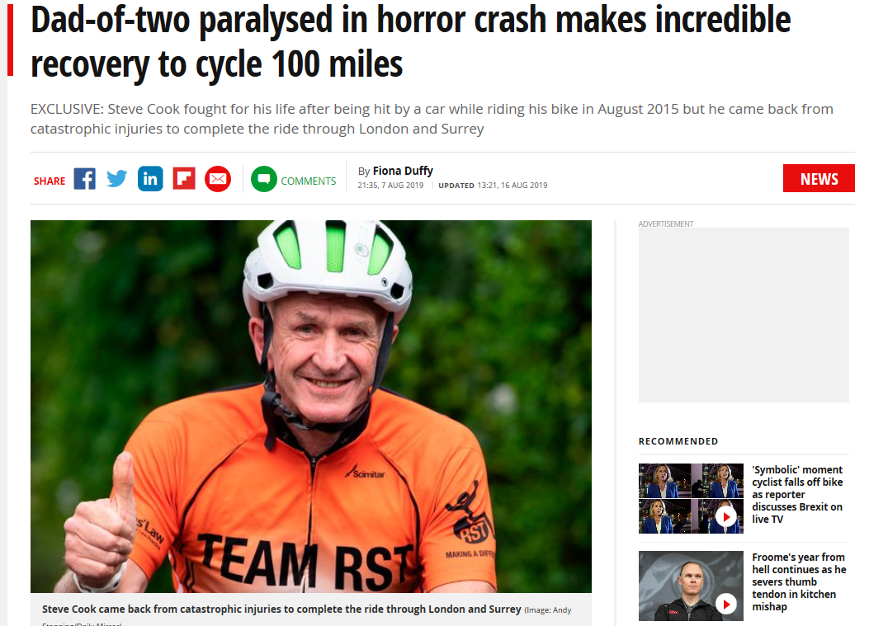
Ride 100
Notes:
SC - your ride 100 story

Slide 11
Any questions?
https://uk.virginmoneygiving.com/fundraiser-display/showROFundraiserPage?userUrl=MariannesAngels&isTeam=true
“Highlighted as 'true specialists in personal injury matters' Stewarts Law LLP Leeds is described as 'the pre-eminent firm for catastrophic injury claims'.”
(Legal 500)
"They're the best at what claimant solicitors do. If you had an injured family member, you'd want to take them to Stewarts every time."
(Chambers UK)

