Slide 1
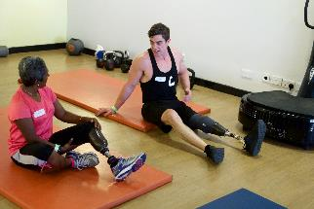
Tackling Inactivity
Encouraging Active Recreation
Andy Brittles
National Sports Development Officer

Slide 2



Over 11 million disabled people and that number is increasing…….
Confidence and self esteem are two of the barriers that people quote.
There are many opportunities to become active but ……..

Slide 3
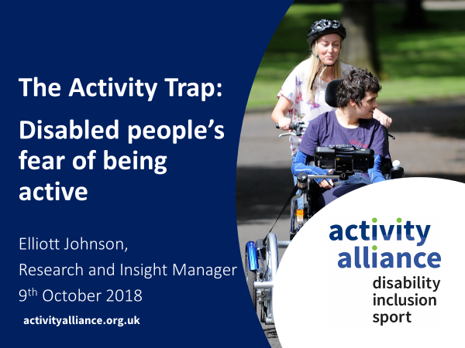
http://www.activityalliance.org.uk/how-we-help/research/the-activity-trap

Slide 4
Definitions
Exercise - Exercise is physical activity that is planned, structured, and repetitive for the purpose of conditioning any part of the body. Exercise is used to improve health, maintain fitness and is important as a means of physical rehabilitation.
Physical Activity - An activity involving physical exertion and skill in which an individual or team competes against another or others.
Sport - Physical activity is defined as any bodily movement produced by skeletal muscles that requires energy expenditure.
ACTIVE RECREATION
Notes:
The fitness industry/sector.

Slide 5

Sport is like………

Slide 6
So who provides sport in this country
Sport England
National Governing Bodies of Sport (NGB)
Active Partnerships (county)
Local Clubs- private or community
Local Authorities
Private Leisure Providers
3rd Sector
Age UK and others
Gymnasiums
Leisure Centres
Play groups
Play schemes
Schools
HE/ FE
National Disability Sports Organisations
Activity Alliance

Slide 7
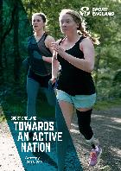
Sport England Strategy
Increase the number of adults using the great outdoors for exercise and wellbeing
Contribute to UK and home nation performance in major sporting events at home and abroad (through our various projects to support talented individuals)
Increase investment in sport from sources outside the public sector
Increase the number of people volunteering in sport at least twice in the last year
Make sure volunteers are from a wider range of backgrounds and lifestyles to ensure this group represents society as a whole

Slide 8
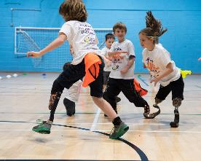
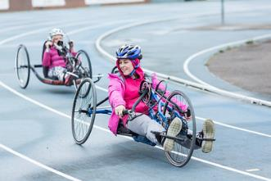
Sport England Strategy
Increase the number of people in England taking part in sport and activity and decrease the number of people who are physically inactive
Increase the proportion of young people (11-18) who have a positive attitude to sport and being active
Make sure public facilities are used fully and effectively to get maximum use from communities
Increase the number of children who are physically literate – i.e. confident and competent in sport and activity

Slide 9









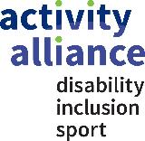


Slide 10
So who are LimbPower
National Disability Sports Organisation helping amputees and people with limb impairments reach their sporting potential. Our objective is to increase the number of ambulant disabled people playing sport and to address the impairment specific differences among our community.
Established in November 2009 by Kiera Roche.
Developed the Primary and Junior Games run at Stoke Mandeville
One of the 7 National Disability Sports Organisations (NDSO) and was recognised in July 2014
Secured Sport England funding in October 2014

Slide 11
Our Aims and Objectives
To increase participation in sport, physical activity and the arts
To engage amputees and individuals with limb impairments in sport, physical activity
To educate individuals with limb impairments about the health benefits of physical activity to improve fitness and well-being.
To provide information on participation, coaching and volunteering opportunities.
To reduce barriers to participation, reduce isolation and promote inclusion.
Build relationships and partnerships to create early engagement, regular participation and inclusion opportunities.
Notes:
The fitness industry/sector.

Slide 12
How we do that….
Advice and guidance to patients, staff, sports organisations and voluntary groups.
Provide talks to user groups, patients and professionals on sport and physical activity.
Run multi sports events for adults and young people.
Deliver activity courses for new amputees and also sport specific activity sessions.
Develop resources to support an increase in participation.
Collect data to support development of opportunities
Challenge sports providers to be inclusive.

Slide 13
So what we offer
Providing opportunities to get active with a focus on mental wellbeing not just sport.
Inclusive or exclusive - a focus on what people want.
Taking activities to the people – for young and old
Providing centres with a volunteer
Connecting people to existing programmes or opportunities.
Directing people to opportunities appropriate to their ability.
Low level activities – Nordic Walking, Walking Football, Walking Netball, Walking Rugby.

Slide 14
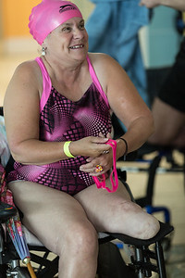
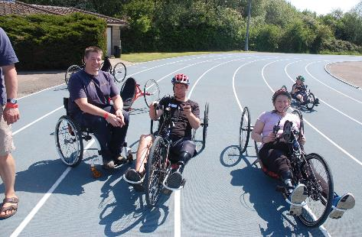
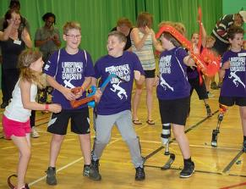
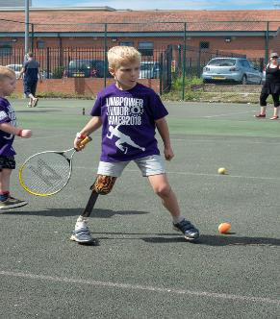
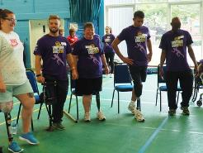
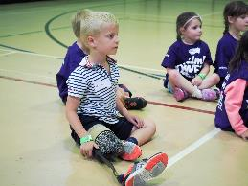
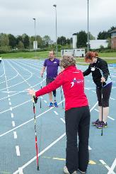
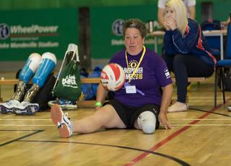
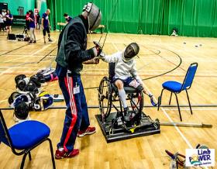
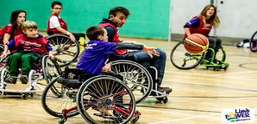

Slide 15
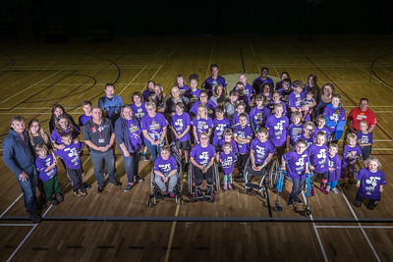
Any questions?
Thank You

Slide 16
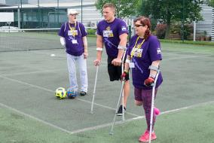
Contact details
If you would like more details on volunteering, activities or our work contact:
Andy Brittles
National Sports Development Officer
LimbPower
andy@limbpower.com
07503 030702
www.limbpower.com
Notes:
The fitness industry/sector.

