Slide 1
Finding your way through the Fog
By Amy Fielding, Senior Associate
Thursday 19 September 2019 at EMSeven

Slide 2
Background
Unlike other law firms, Stewarts focus exclusively on claims involving serious injuries, in particular brain injury, birth injury and spinal cord injury.
Life-changing injuries where the whole structure of a client’s previous life may be affected.
This talk will focus on the principle of personal injury litigation and compensation generally. Ultimately, focussing on the importance of knowing your client as a person. Not only knowing their detailed pre-injury position but their personality, their motivations and their influences.
Establishing from as early as possible their ‘wants’ alongside their actual needs.
Working from the onset to build a case that gets the client what they really want for their future.
Achieving any goals that they may have hoped to have achieved had they not been injured.
Stewarts we have small caseloads to allow a client/person focussed approach from day one.

Slide 3
Aim of Presentation
This basic principles for a compensation claim
To provide an understanding of how we build a claim for damages for serious injuries
The difference between clinical negligence and personal injury cases
Understanding how to try and rebuild a client’s life through damages, where possible.
Question: How many people here have brought a claim for compensation?

Slide 4
The Aim of Compensation
Compensation is an award of damages/money to provide an unlawfully injured person for all the losses expected to be suffered by them for the rest of their lives as a result of their injuries.
No more or no less than they need.
Insofar as an amount of money can, it should place that person back into the same position as they would have been ‘but for’ their injuries.
Claims in the UK are based on 100% compensation principle.
Notes:
GR’s notes: Doctors owe a duty of care to their patients; Bolam –v- Friern Hospital Management Committee [1957] – established the legal benchmark that a doctor’s duty is to exercise skill and care according to the ordinary and reasonable standards of those who practice in the relevant field of medicine; Bolitho –v- City and Hackney Housing Authority [1977] the treatment would not be negligent if it is capable of withstanding logical analysis.
Causation – the breach caused / materially contributed to the injuries and loss

Slide 5
Clinical Negligence & Personal Injury Claims
Clinical Negligence
Claims against hospitals, clinics, doctors, dentists, surgeons, nurses and therapists.
Usually involve claims against the NHS but also against private providers (Spire/BMI/BUPA/Virgin Care) or the individual (private surgeons).
Commonly defended so liability has to be established before any compensation can be calculated.
Interim payments during the case may not be possible.
In these cases, private multidisciplinary team involvement can be delayed for many years whilst breach of duty by a clinician or hospital is proved and the link to the clients injuries established.
Personal Injury
Accidents - RTAs, Accidents at Work, Occupier’s Liability (claims within someone’s premises), travel and holiday claims.
Usually involve an insurance company providing cover for the person or company who caused the accident or was at fault.
Commonly liability is established or admitted from the onset so compensation can start to be calculated from the beginning.
Interim payments are easier to obtain at the early stages of the claim.
Clients can start to use their damages to repair their lives at the earliest opportunity. Care packages, private therapy, case management, housing, equipment,
Notes:
GR:’s note: NHS Trusts will give an apology where there is an admission of breach of
duty and causation.

Slide 6
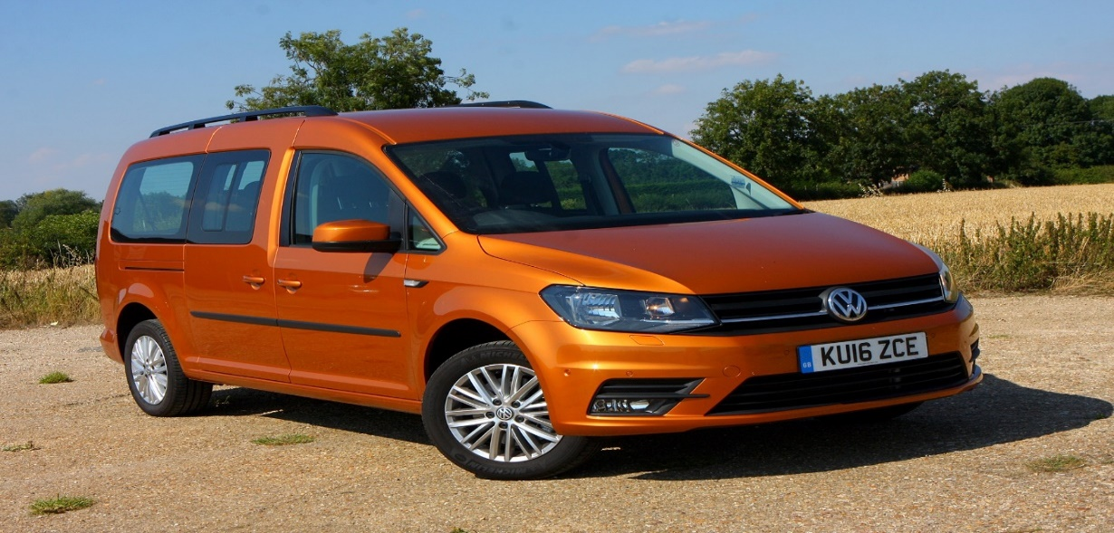
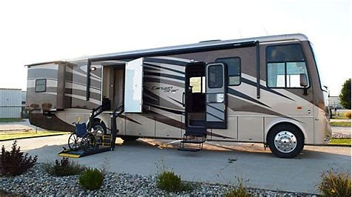
Headings of Loss
General Damages – Payment for the actual injury/injuries – JC Guidelines – Tariff scheme
Loss of Earnings/Pensions – in full or in part where a client could return to some form of work
Care and Case Management – Largest part of most claims
Accommodation – Adaptations and any purchase costs for a suitable property.
Travel and Transport – Vehicles/Drivers/Car adaptations/Motorhomes/Taxis/Private Ambulances
Notes:
GR’s note: For example, in a discitis and spinal abscess case concerning GP treatment and care at two NHS hospitals, to investigate breach of duty and causation we required 6 liability experts in the fields of general practice, microbiology, neurosurgery, spinal cord injuries, spinal orthopaedics, and neuroradiology.

Slide 7
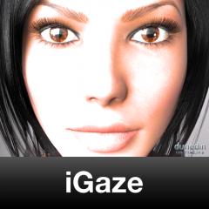
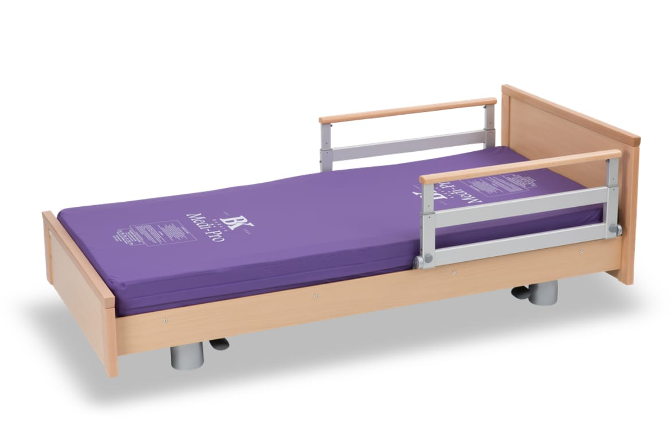
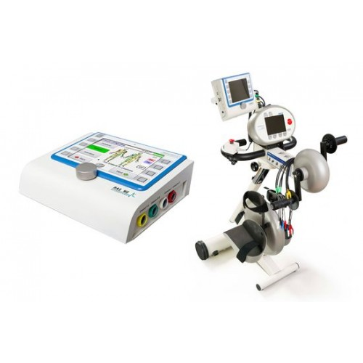
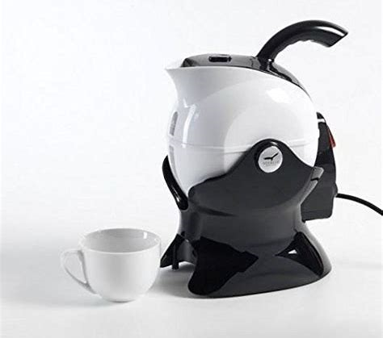
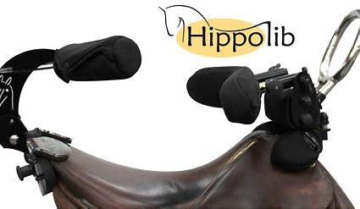
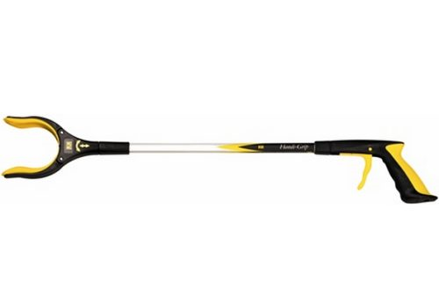
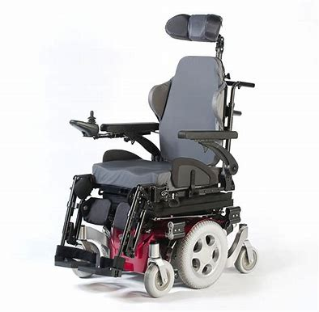
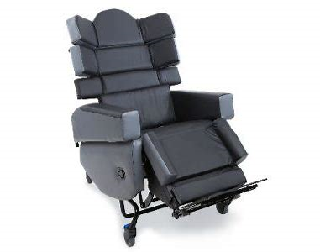
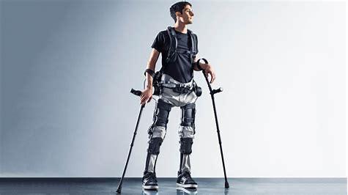
Headings of Loss cont….
Aids and Equipment – Limitless options – Anything to allow the person to achieve their Activities of Daily Living. In any way possible…..

Slide 8
Headings of Loss cont……..
Medical and Therapy Costs
Private inpatient treatment/rehabilitation periodically throughout life
Physiotherapy, Hydrotherapy, Massage Therapy
Occupational Therapy
Private Psychology/Counselling
Inpatient admissions for treatment – addictions, PTSD, Counselling (immediate and future provision)
Private Annual Reviews – Spinal, Brain Injury – Private MDT with Care Package Providers
Art Therapy
Music Therapy
Private Educational assistance/Tutors for Children
Speech Therapy

Slide 9
Headings of Loss cont……
Holidays
Previous holidays in the years before injury. Short breaks, two weeks, two months?
Family holidays – activity holidays – skiing, sailing, scuba diving, trekking.
Other children within the family.
Additional costs to carry out same level and style of holiday as before holiday.
Upgrading flights to allow space for travel.
Cost of transporting equipment required.
Additional costs for accommodation.
Additional costs for carers travel and accommodation.
Additional travel costs at destination – car/WAV hire, taxis etc.
Notes:
GR Note: Interim payments agreed in Protocol stage – last time – approximately 6 years ago; two recent case examples where liability was denied until the week or days prior to exchange of liability expert evidence –15/20 months after the Protocol stage.

Slide 10
Headings of Loss cont……
Miscellaneous costs
Clothing – fastenings, fitting, type of clothing.
Footwear – fitting, sizing, fastenings.
Anything else????
Any cost/purchase that flows from the claim and will try to return the person into the position they would have been (where possible) but for their injuries……
Notes:
GR note: – currently in the RCJ, CCMCs are being listed around 5 months after filing Directions Questionnaire

Slide 11
Examples of finding ways around client’s injuries
Client SS
Owned 12 horses before her injuries.
6 berth motorhome with platform lift to attend meetings/events.
Tail lift access adaptation to horseboxes
Live-in groom/assistant to deal with day to day upkeep of onsite stables and horses.
A range of adapted riding equipment to enable her to return to riding.
A specialist hoist to enable her to mount and dismount the horses into her wheelchair.
All terrain specialist wheelchair to access as much of her land and stables as possible.

Slide 12
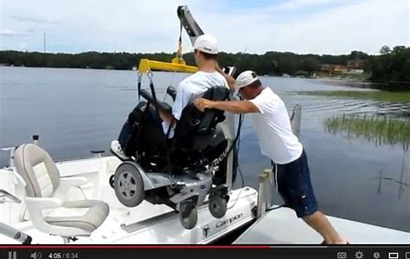
Client: PM
6 berth motorhome with platform lift to allow travel in excess of 1 hour due to pressure injuries
Mobile hoist and sling to allow care staff to mobilise onto bed in mobile home.
Lightweight air fluidised alternating cell mattress to allow pressure relieving whilst in motorhome.
All terrain wheelchair to allow access to all areas.
Previous fisherman on his father’s boat on the East Coast.
Claimed for adaptations to a boat to allow wheelchair access and to allow client to remain in specialist wheelchair with high specification pressure cushion.
Hoisting adaptations on the boat to allow client to move from his wheelchair, if required.
**any client with pressure injuries**
Notes:
GR’s note: example timescale – CCMC in March 2017; Trial in October 2018

Slide 13
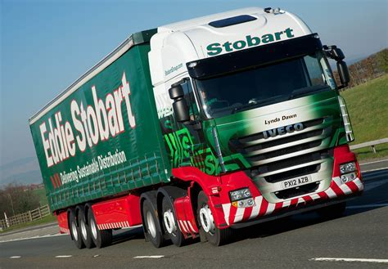
Client: PR
Previous avid lorry spotter spending 5-6 days a week driving around the roads of the UK.
Owner of 3 high specification MPVs. She spent most of her money on motor vehicles.
Attended national lorry-spotting events annually.
Largely bedridden since injury.
Motivated entirely by returning to her hobby and pastime.
Claiming for a high specification drive on WAV with all carers able to drive.
Claiming for additional carer travel and accommodation costs to allow attendance at lorry-spotting events.
All-terrain wheelchair claimed as most events largely field-based events.

Slide 14
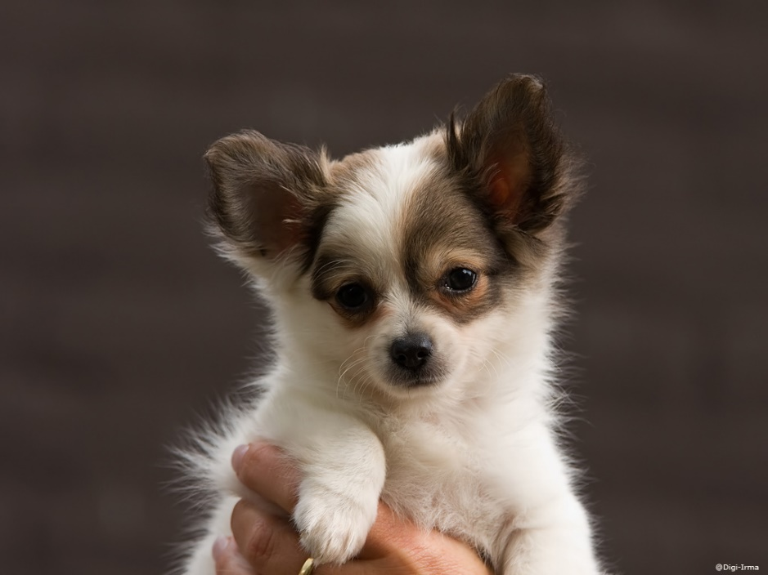
Client: MM
Client had been homeless since early teens.
Suffered a catalogue of unhealthy, violent and controlling relationships pre-injury.
Huge issues with alcohol and drug addiction.
Developed spinal infection (discitis) but was not taken seriously at hospital despite 3-4 attendances.
Suffered complete paraplegia and permanent wheelchair reliant. Liability admitted and interim payments arranged.
Attempted to manage her addictions but after 2 years sobriety relapsed.
Started another relationship with a violent, controlling partner motivated by her claim.
Private Case Manager brought in but long periods when difficulty contacting client.
Finally, managed to plan a route for her to leave her partner and enter inpatient drug detoxification and rehabilitation.
Client agreed to pay for her rehabilitation from her damages in order to improve her life.
On completion arranged temporary accommodation near the recovery clinic.
She felt very alone in the world with her new sobriety
She was very reliant on her care package.
Due to her history of building unhealthy dependent relationships, she wanted a dog.
Meet Princess! 4 years now with MM and going strong. Both sober and happy.

Slide 15
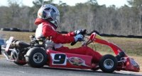
Client: GK
Client was spinally cord injured.
Used to go go-karting with his son regularly. Also carried out mechanics on karts.
Claimed for a professional mechanic to assist with karts for future.
Initially still went to watch his son go-karting and takes pressure cushion to sit on.
With assistance x 2 tried a go-kart and once in was able to drive as normal.
Claim included costs for assistance to go-karting for 1 weekend a month.
Costs for annual mechanic as previously would have carried out all work himself.
Costs for an automatic double awning when go-karting as previously was able to put up himself.
Double awning required for the go-karts and his wheelchair.

Slide 16
Non-Client: CD
Shoe-aholic, dog enthusiast, private client lawyer.
Known throughout her office for her vast array of shoes.
If injured she would like to be able to continue this hobby, if at all possible.
Not straightforward, for instance SCI patients often go up at least one shoe size.
Also lack of sensation to feet can lead to risk of pressure injuries.
Claim for replacement shoes in new sizes.
Claim for pressure relieving pads to insert into the shoes and regular podiatry!

Slide 17
Non-Client: TM
Sheffield Wednesday ‘Super-Fan’ and private client lawyer.
If he was injured (and presumably not working or part-time), he would like to spend his time following SWFC through the season attending as many, if not all, games across the country.
How would you accommodate this in any claim?
Any additional costs for his season ticket above what he had paid for prior to his injury.
A suitable vehicle that he could drive (if possible) or his family or carers could drive.
An allowance for overnight accommodation at any away fixtures with space for carers’ accommodation, as required.
If wheelchair reliant, a suitable lightweight manual/power wheelchair and pressure cushion to allow him to easily negotiate the grounds and any stadiums.
Sufficient care to allow travel time to and from any fixtures and to assist throughout any games. Preferably also Sheffield Wednesday supporters but not a prerequisite for recruitment of carers.
Notes:
GR’s note: 2 weeks?; 4 weeks?; 3 months?; 6 months?

Slide 18
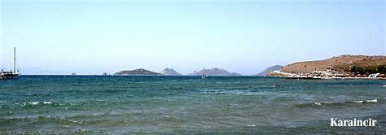
Client: PG
Pre-injury client spent 3 week+ holidays in Turkey for years with his wife. They had a house in Karaincir.
Suffered a spinal cord injury and could not manage with flights and suspected their travels were over.
He was also unable to work so no longer had this to fill his days.
Claimed for an adapted motorhome and the adaptations to the grounds of their home to allow wheelchair access.
Now takes long holidays with his wife driving to and from Turkey.
Following settlement of the claim they contacted us to let us know they had made it to Turkey in their motorhome. His wife had driven them all the way there. They had taken a ferry from Hull to Zebrugge. Then to Turkey via…..Holland, Germany, Austria, Croatia, Serbia, Macedonia and then Greece.
All in 5 days.
Part of the claim was also for a carer/driver to relieve his wife when this type of driving became too much.

Slide 19
Any Questions?

